Slide 1
NFC ticket design on MIFARE Ultralight C
Group 7
Soumya Lekkala
Anastasia Safargalieva

Slide 2
Memory layout

Slide 3
Page Number |  | Contains
Decimal | Hex
0-3 | 00h-03h | Serial number and OTP
4 | 04h | Application Tag (constant string specific to our application and ticket design)
5 | 05h | Version (constant string specific to our application and ticket design)
6 | 06h | Maximum counter value
7 | 07h | InitialCounterState
8 | 08h | Issue Date
9 | 09h | First Use(Timestamp when the ticket is used for first time)
10 | A | HMAC from issue
11 | B | HMAC from use
41 | 29h | Counter used for rides
42 | 2Ah | Authentication configuration (auth0 set from 06h)
43 | 2Bh | Authentication configuration (auth1 set to 0 to restrict read and write access)
44-47 | 2Ch-2Fh | Authentication Key

Slide 4
Implementation

Slide 5
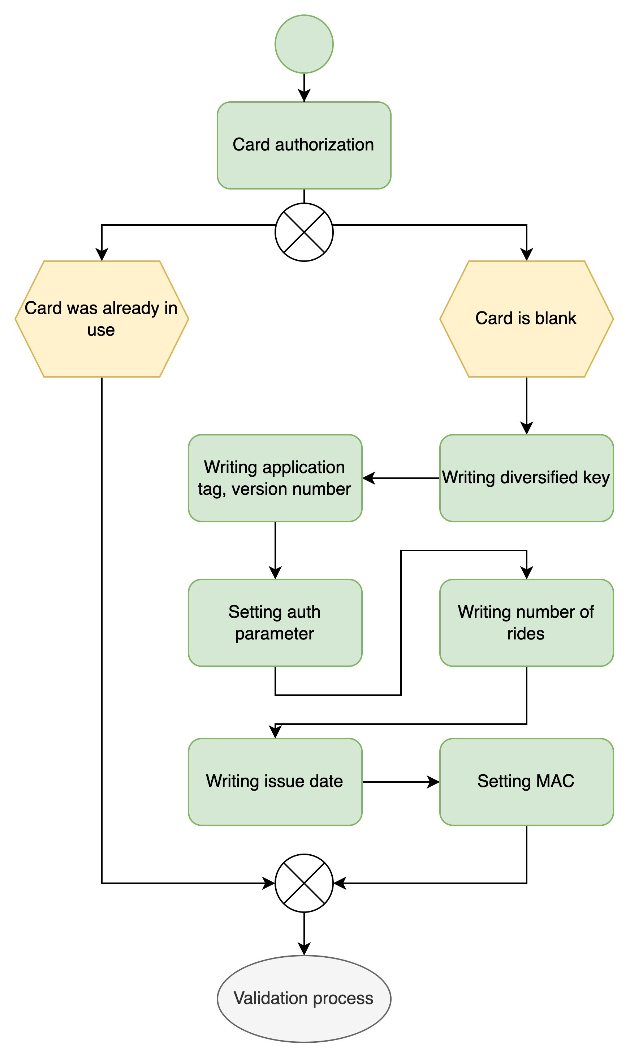
Issuing ticket
Ticket issuing is a complex operation which is usually done by trained staff or by placing the card into a writer device for some seconds, which reduces the risk of tearing.
During issuing we:
Setting auth parameter
Computing and writing diversified key
Writing application tag, version number
Number of rides
Issue date
MAC

Slide 6
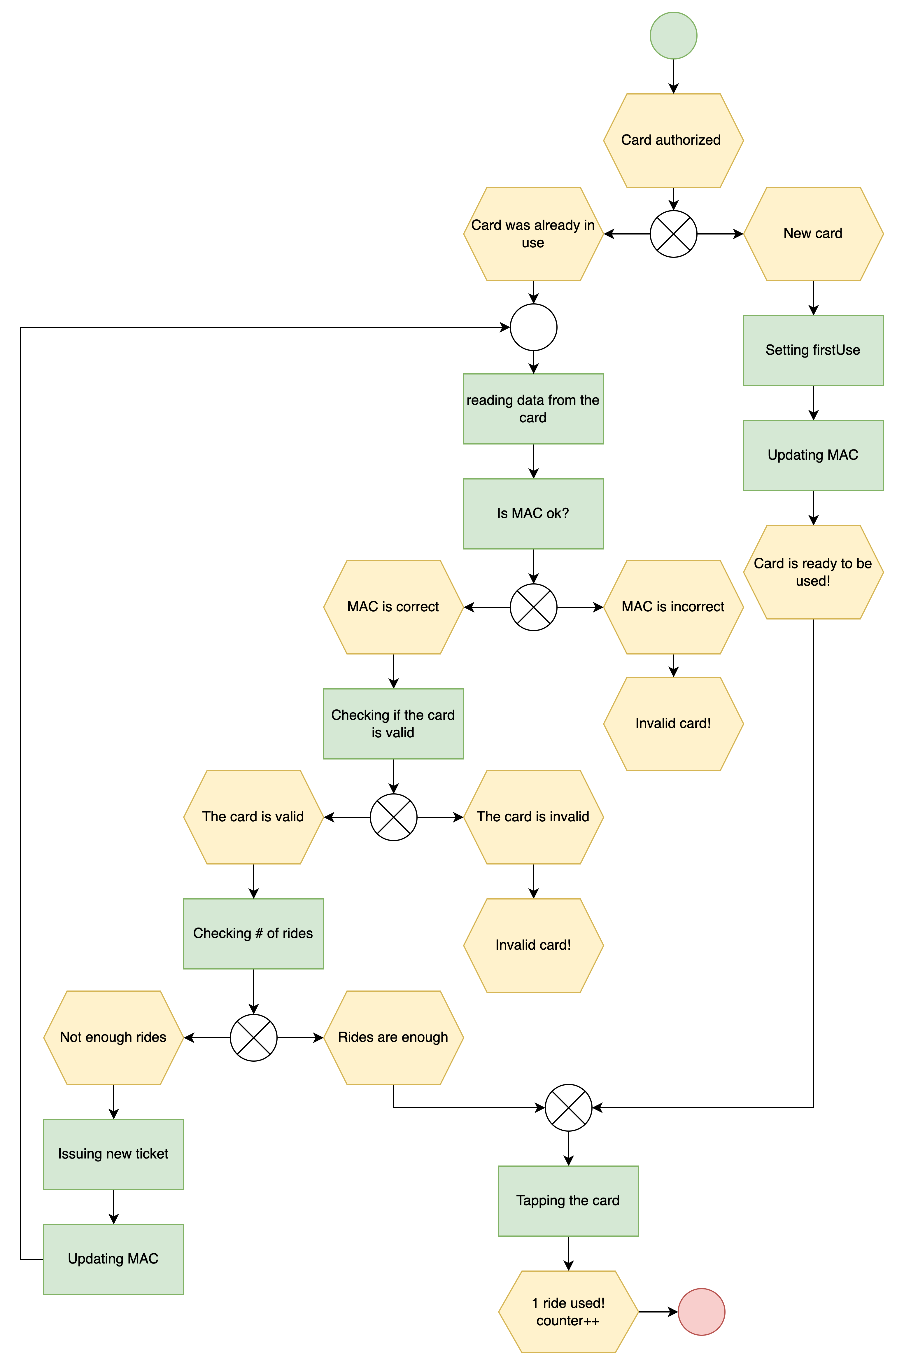
Ticket validation
Validation of the new card will require setting firstUse date
Validation of the card that was used before includes reading the date from the card, checking if HMAC is correct and the ticket is still valid.
If HMAC is incorrect, then the ticket is invalidated.
If the number of rides is not enough or the ticket is outdated, then we issue new rides.
After we tapped the card, we increment the counter.
If tearing happens at any step, the user can retry.

Slide 7
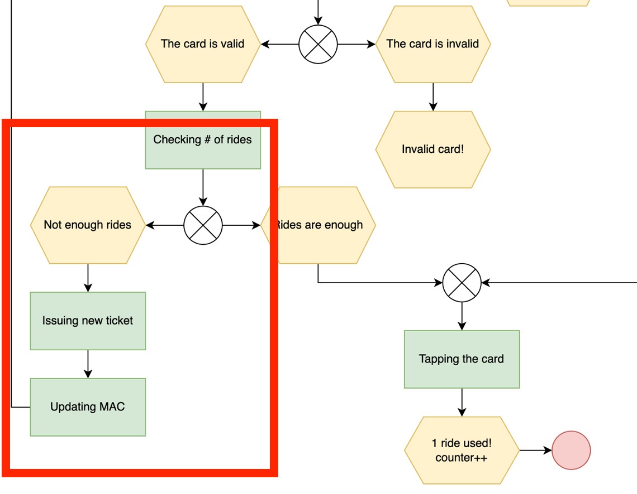
Adding new rides
If the ticket is not expired, we can add additional rides to it.
During this process we update page 6 – Number of maximum rides and then update MAC.

Slide 8
Security design

Slide 9
Counterfeit tickets
Mutual secret key authentication (pages 44-47) allows to check that the ticket is authentic.
Setting authentication parameters:
AUTH1 (page 43, byte 0) – read and write operations are restricted
AUTH0 (page 42, byte 0) – contains the address of the page from which access rights defined in AUTH1 are applied.

Slide 10
Key Diversification
Each card has its own key specific key, which is calculated as following:
Auth Key = SHA256(Master Secret || Card UID)
This prevents affecting other tickets in the system if the key was leaked. Even if the key was leaked, the attacker would still need to get master secret, which is stored secretly and the rest of the cards won’t be affected.

Slide 11
Man-in-the-Middle attack
In order to prevent the attacker from modifying the content of the card, we compute MAC to protect the integrity of the card.
With MAC, even if the card was tampered, the tampering will be discovered.
HMAC Key = SHA256(HMAC Master Secret||Card UID)
MAC = HMAC(application tag||version||counter state|| issue date || first use)
Mac contains only static data. It is written in one page on the card since it is only 4 bytes.

Slide 12
Rollback attack
A kind of man in the middle attack where the card is authenticated with a reader and the attacker rewrite old data into the card including the HMAC.
To prevent it, we use the counter in page 41 to count used rides, which is done by incrementing the number of rides. Even if the attacker copied old data and then wrote it back to the card, the counter can’t be decremented and as a result, there are no additional rides are given.

Slide 13
Tearing attack
Tearing happens when we move the card very quickly from the reader and the ticket cannot be read properly.
Tapping operations do not update MAC or other multi-page content on the card.
Every time we tap the card, we change the value of the number of taken rides only.
Card authentication and MAC is used to protect static content of the original, issued ticket, such as expiry date. Then, we use the 16-bit counter to keep track of how much of the issued ticket has been used.
If it is the first use of the ticket, following writing operation happen:
Setting firstUse time
Updating MAC including firstUse
Incrementing the counter

